Slide 1


Handling Flaky Tests
What is Flakiness?
Tests that sometimes fail for non-deterministic reasons like network glitches, timing issues, or CI load variations.
Playwright's Solution
Re-run failed tests automatically and use annotations to mark known-broken tests for team visibility.
Retry Configuration Options
01
02
Global Config
Per-file Override
Set retries in playwright.config.ts - best for CI environments
Use test.describe.configure({ retries: }) for specific test suites
03
CLI Command
Run npx playwright test --retries=3 for immediate control
Best Practice: Enable 1-2 retries in CI to avoid transient failures, but always triage root causes. Don't mask real bugs with high retry counts.

Slide 2
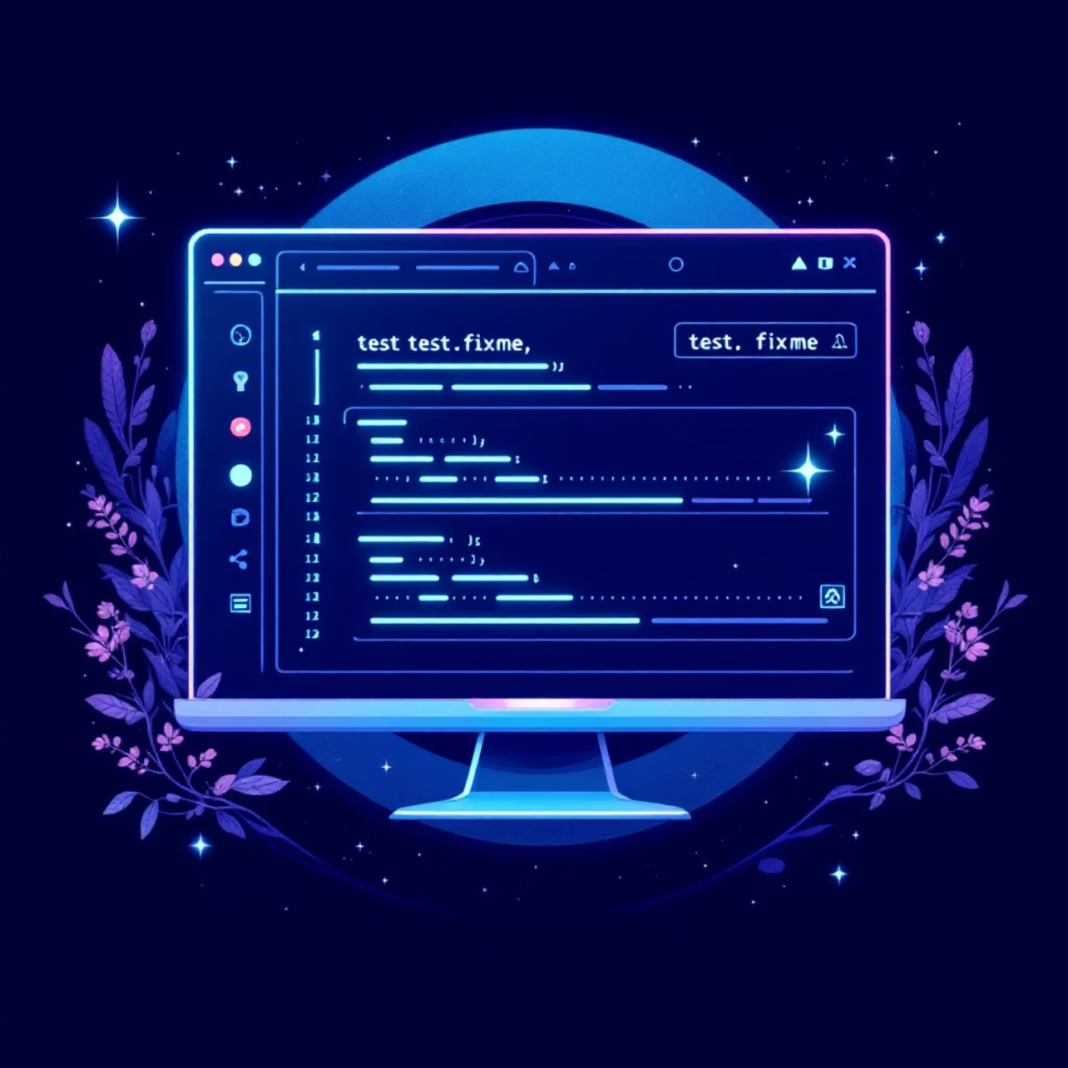
test.fixme() for Known Issues
Mark Tests Needing Attention
test.fixme() marks tests as "known failing" - Playwright won't run them but shows them in reports so team members know they need fixes.
When to Use
Test broken by known issue
Crashy or very slow tests
Want visibility without execution
import { test } from '@playwright/test';// This test shows as 'fixme' and won't executetest.fixme('Known race on Safari', async ({ page }) => { // test body (won't execute)});

Slide 3
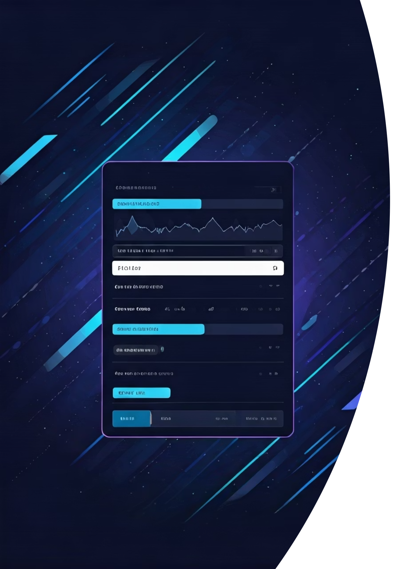



Smart Screenshots & Visual Testing
Full Page Capture
await page.screenshot({ fullPage: true }) captures entire scrollable page for complete visual verification.
Element-Only Shots
await page.locator('.header').screenshot() focuses on specific components for precise testing.
Visual Comparisons
await expect(page).toHaveScreenshot() compares against stored baselines to catch visual regressions.
Reducing False Positives
Mask Dynamic Content
Set Pixel Tolerance
Hide timestamps, ads, and user avatars that change between runs
Use maxDiffPixels for minimal differences like anti-aliasing
Component-Level Focus
Prefer smaller scope snapshots to reduce noise on complex pages

Slide 4
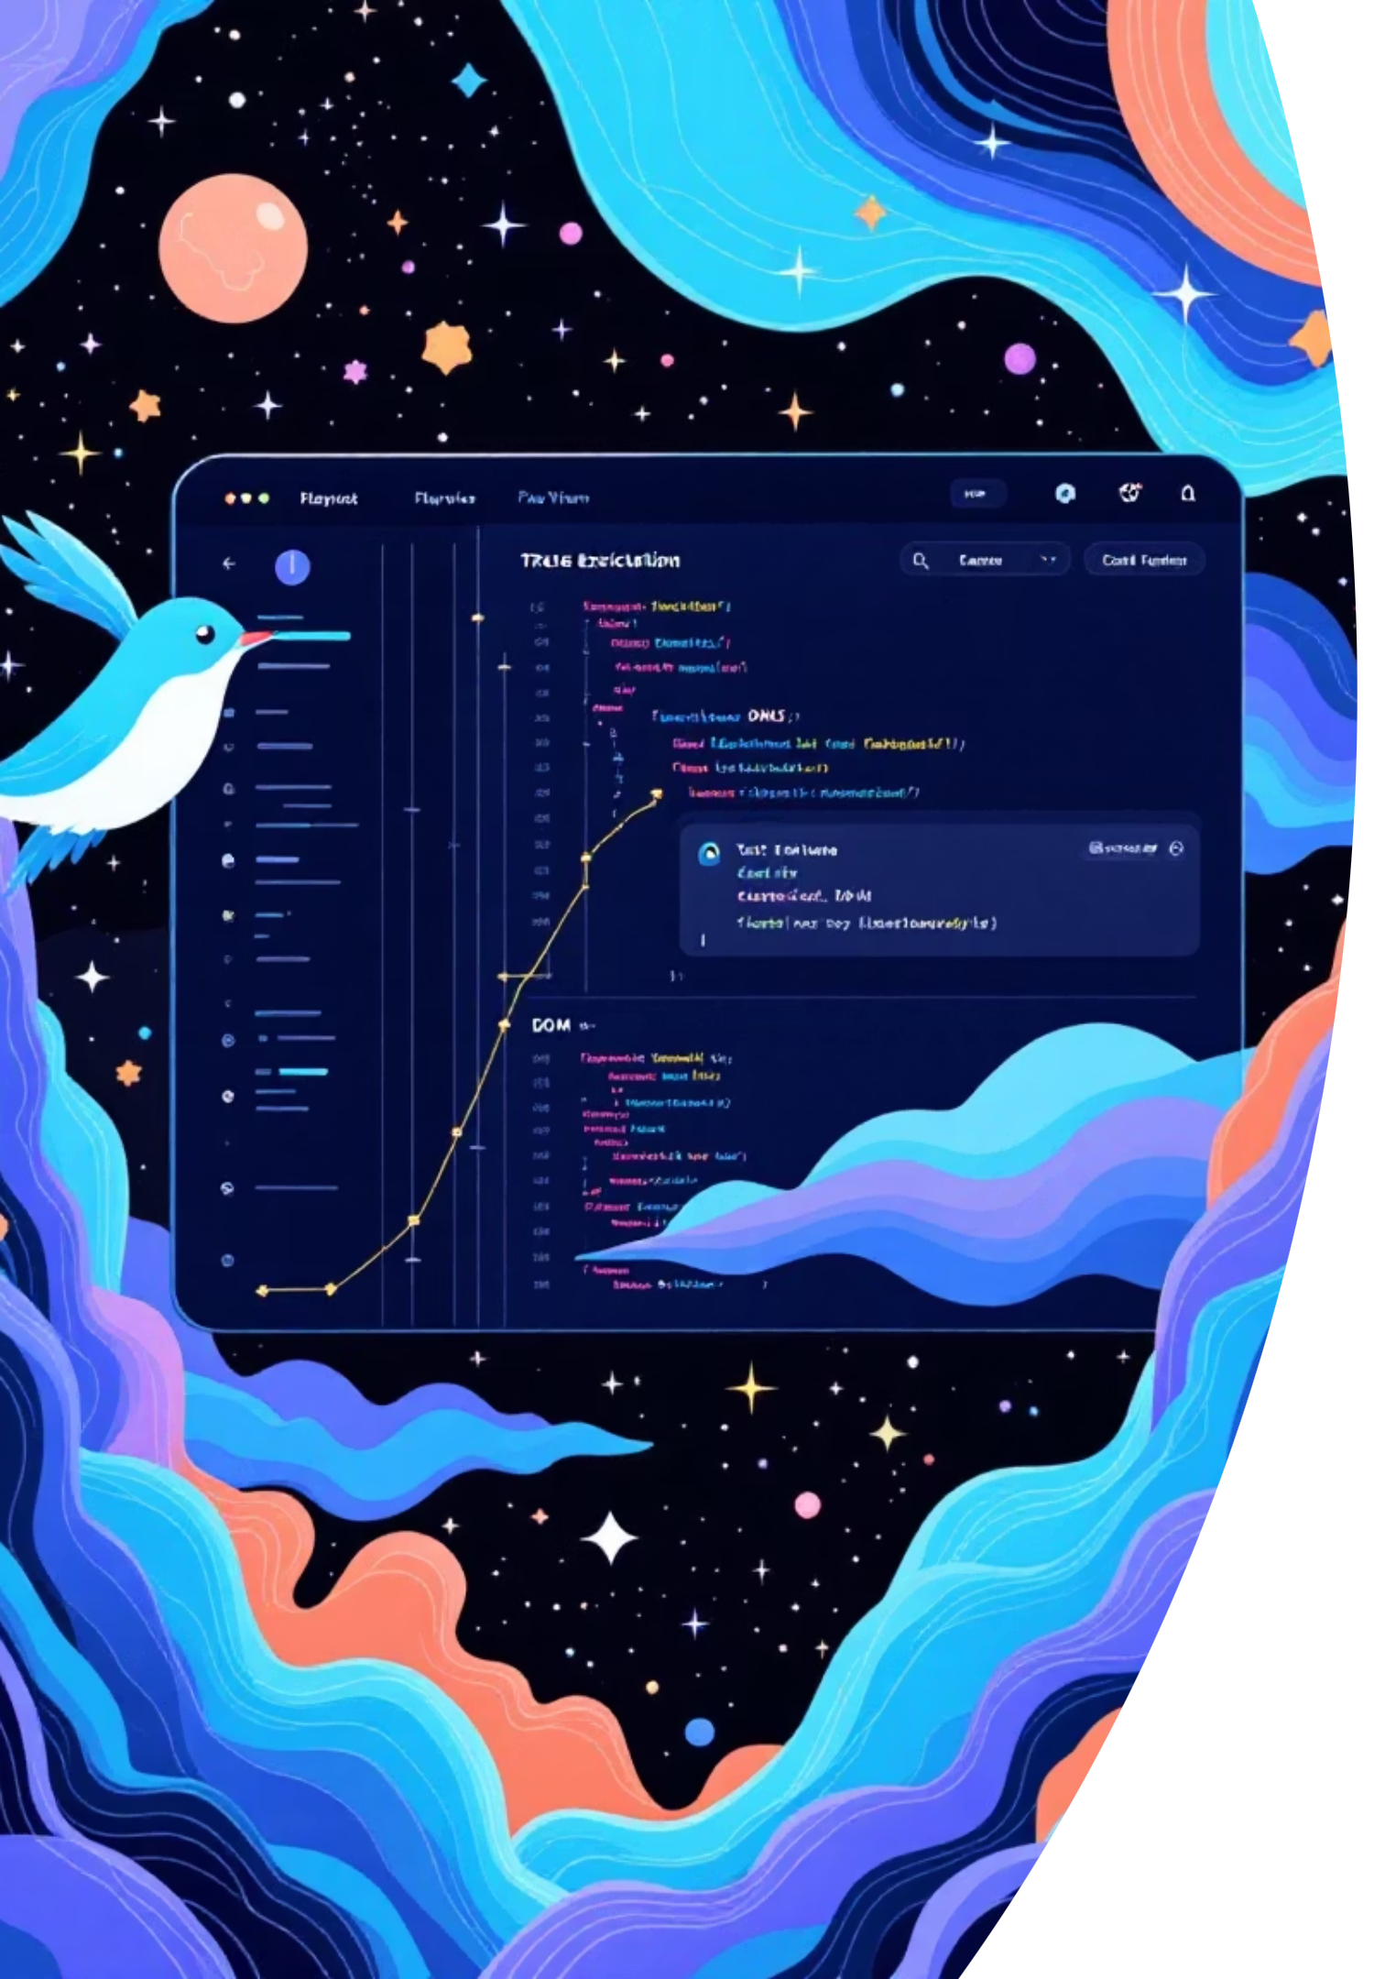




Tracing for Powerful Debugging
Flight Recorder
Time-correlated trace with DOM snapshots, screenshots, console logs, and network activity for complete test replay.
Step-by-Step Replay
Trace Viewer lets you replay failing tests action by action - invaluable for CI failures.
Enable Tracing
Config Method (Recommended)
Programmatic Control
Set trace: 'on-first-retry' in playwright.config.ts for optimal balance of artifacts and performance.
Use context.tracing.start() and stop() for fine-grained control around specific flows.
CLI Override
View Results
Use npx playwright test --trace on for immediate debugging needs.
Open traces with npx playwright show-trace path/to/trace.zip in the interactive Trace Viewer.

